Slide 1
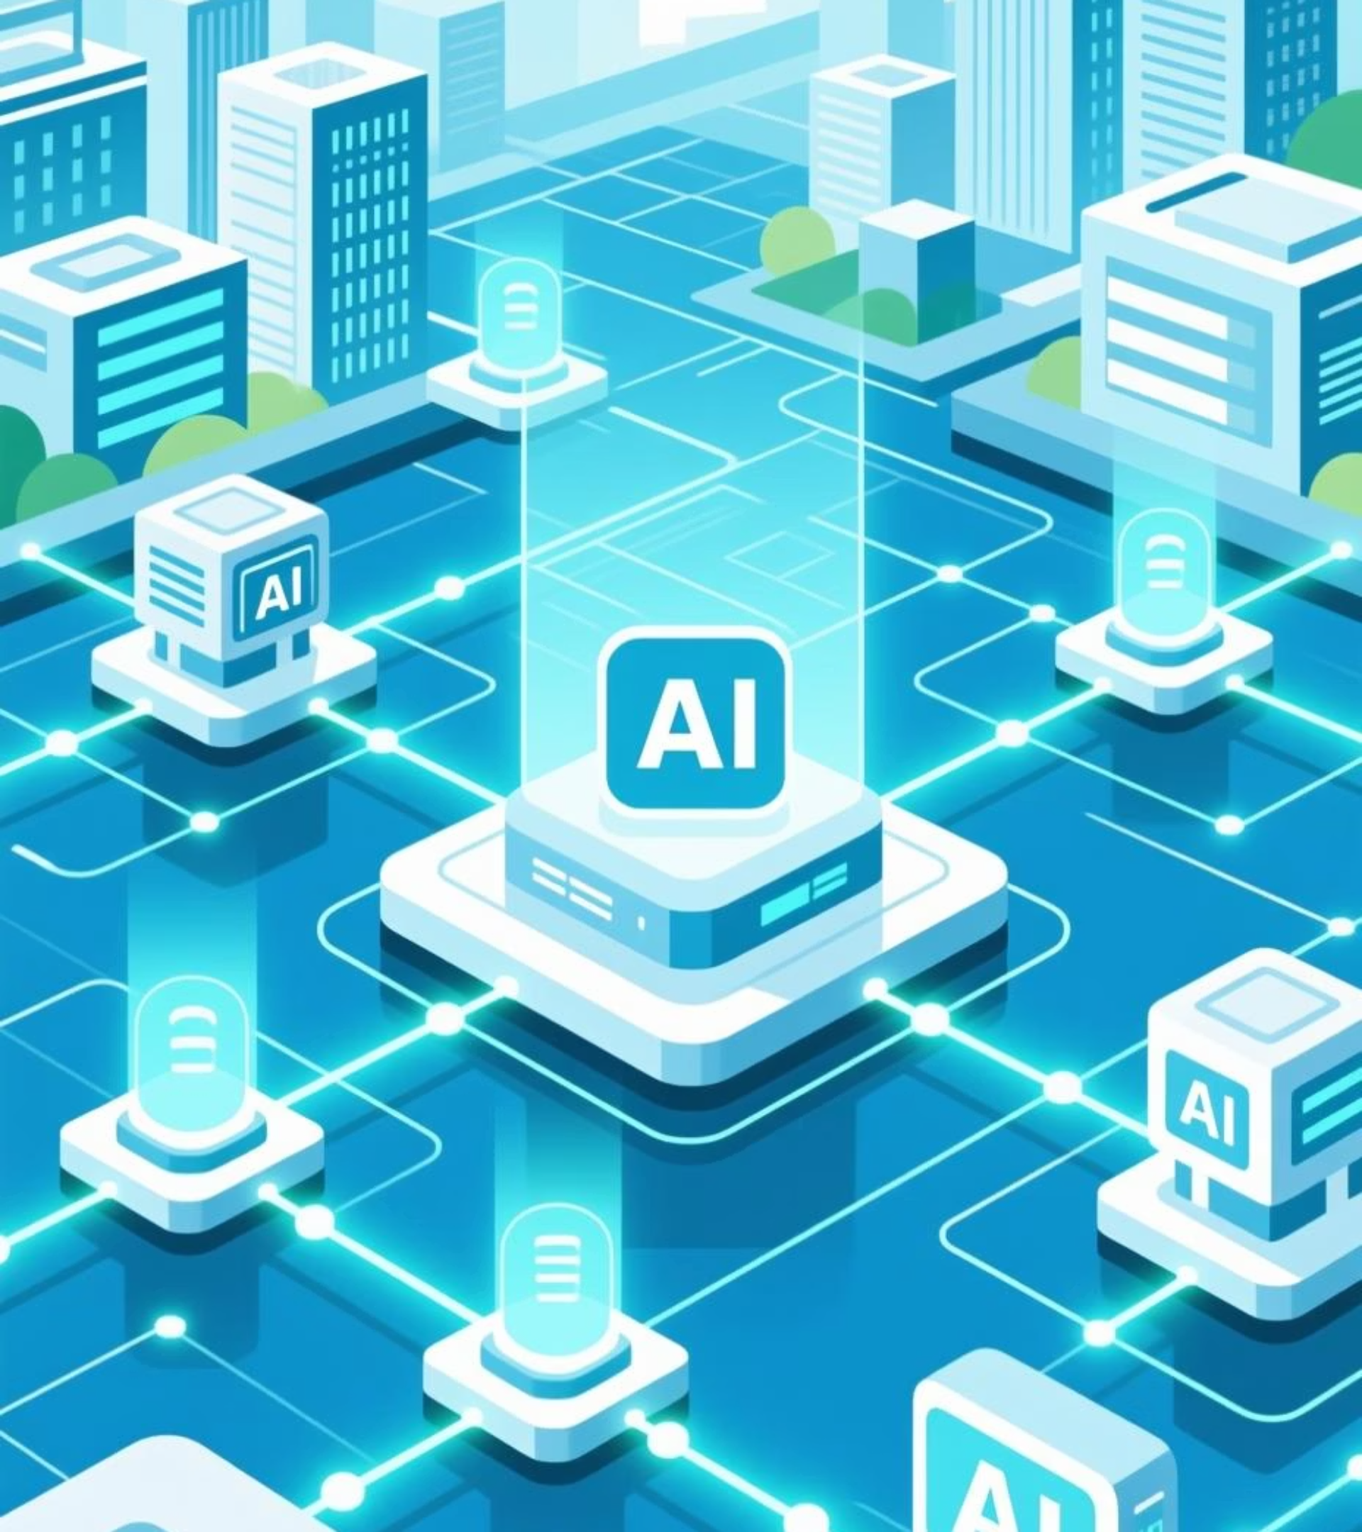
Yukawa.AI -Vision – Building The “Unified Enterprise Intelligence” For our clients

Slide 2
Vision for Yukawa.AI
Building the “ Unified Enterprise Data and Intelligence Platform
Unified Enterprise Data & AI Platform
Top Databricks Partner & Cloud-AI Innovator
Agentic AI Consultancy
Lakehouse & Delta architectures, best-in-class governance
Harnessing cross-domain data & AI experience
Managed, centralized, and governed foundation
All enterprise data unified → single source of truth -> Analytics + AI foundation
Cloud-native, scalable, multi-cloud ready
Intelligent Agents automating and optimizing enterprise workflows
Unity Catalog, MLOps, and continuous optimization
Generative + classical AI and data fusion
Enabler for analytics, AI, and automation

Slide 3
Vision for Yukawa.AI
Yukawa : Strategic Pillars & Differentiation
why Yukawa.AI is your best partner for “Data and AI” Vision and Implementation.
Pillar 1 – Unified Enterprise Data & AI Platform
Pillar 2 – Agentic Edge in AI Implementation
Enterprise-wide, governed, and trusted data foundation
Agentic AI – adaptive, context-aware, decision-driven systems
Self-service analytics, forecasting, and intelligent automation
LLMs, Vector DBs, LangChain, Llama Index integration
Built on Databricks + Cloud-native stack (AWS, GCP, Azure)
Continuous learning from enterprise + external data
Standard Best Practices (Our DNA)
☁ Cloud Native | 📊 Data Driven | 🧩 Enterprise Governance | 🤖 AI Native | 🕹 Agentic by Design | Flexible
"Data-Driven. AI-Native. Agentic by Design."

